Slide 1
Using Trio – Juniper Networks’ Programmable Chipset – for Emerging In-Network Applications
Mingran Yang
Alex Baban, Valery Kugel, Jeff Libby, Scott Mackie,
Swamy Sadashivaiah Renu Kananda, Chang-Hong Wu, Manya Ghobadi

Slide 2
Data-intensive applications are the foundation of online services
Machine learning
Databases
Storage
Data analytics
Moore’s law is slowing down
We need efficient distributed systems for data-intensive applications

Slide 3
The rise of in-network computing
Switch
Reduce latency
Improve performance
Computation
Result Packet
Result Packet
Result Packet
Result Packet
Data Packet
Data Packet
Data Packet
Data Packet
Server
Server
Server
Server
Caching: NetCache [SOSP ’17]
Database query processing: Cheetah [SIGMOD ’20]
Machine learning training: SwitchML [NSDI ’21], ATP [NSDI ’21], PANAMA [MLSys ’21]

Slide 4
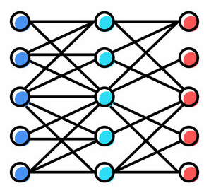
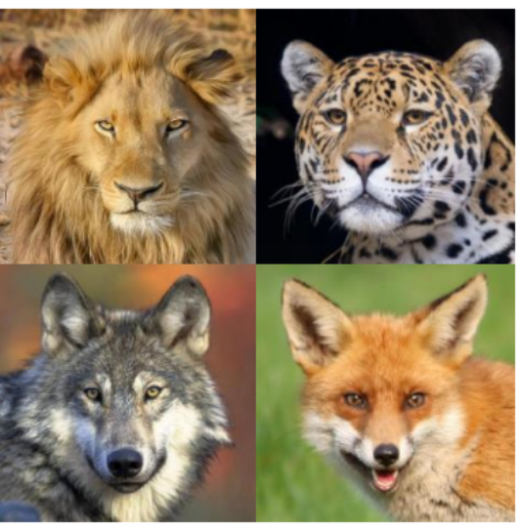
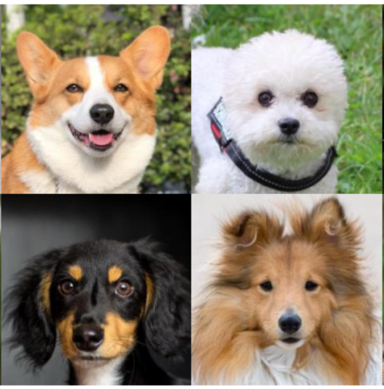
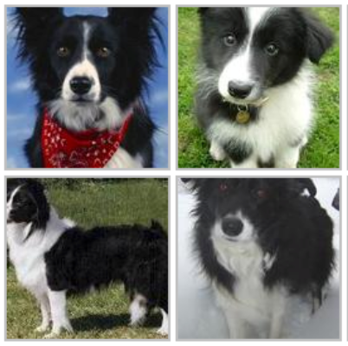
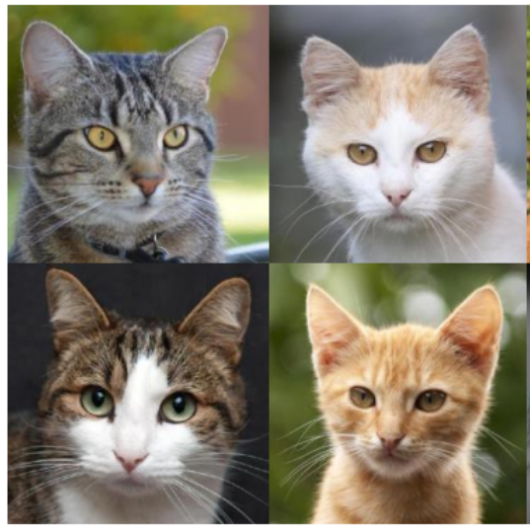
Background on data parallel distributed machine learning training
Switch
Allreduce
Gradients
Gradients
Gradients
Gradients
Server 1
Server 2
Server 3
Server 4
DNN model
dataset
DNN model
dataset
DNN model
dataset
DNN model
dataset

Slide 5
In-network aggregation for distributed ML training
Switch
Σ
Aggregated gradients
Aggregated gradients
Aggregated gradients
Aggregated gradients
Gradients
Gradients
Gradients
Gradients
Server 1
Server 2
Server 3
Server 4
Allreduce puts significant pressure on network fabric
SwitchML [NSDI ’21] and ATP [NSDI ’21] proposed in-network aggregation

Slide 6
Stragglers impose a practical deployment challenge with in-network aggregation
Switch
Uncorrelated performance jitter
Gradients
Gradients
Gradients
Gradients
Server 1
Server 2
Server 3
Server 4
Must wait
Straggler
There has not been much attention to straggler mitigation for in-network computing applications

Slide 7
Enabling efficient in-network straggler mitigation in Tofino switches is challenging
Switch
Server 1
Server 2
Server 3
Server 4
Straggler
The switch needs to perform efficient timer-based operations to mitigate stragglers
Challenge: requires frequent interactions with the control plane
Today’s Tofino-based solutions have no in-network straggler mitigation implemented

Slide 8
Trio-ML Our proposed system for efficient in-network straggler mitigation
Achieve 1.8x faster training time for machine learning jobs by leveraging Juniper Networks’ programmable chipset.

Slide 9
Talk outline
Overview of Juniper Networks’ chipset
Trio-ML: our proposed in-network straggler mitigation for distributed ML training
Evaluations

Slide 10
Talk outline
Overview of Juniper Networks’ chipset
Trio-ML: our proposed in-network straggler mitigation for distributed ML training
Evaluations

Slide 11
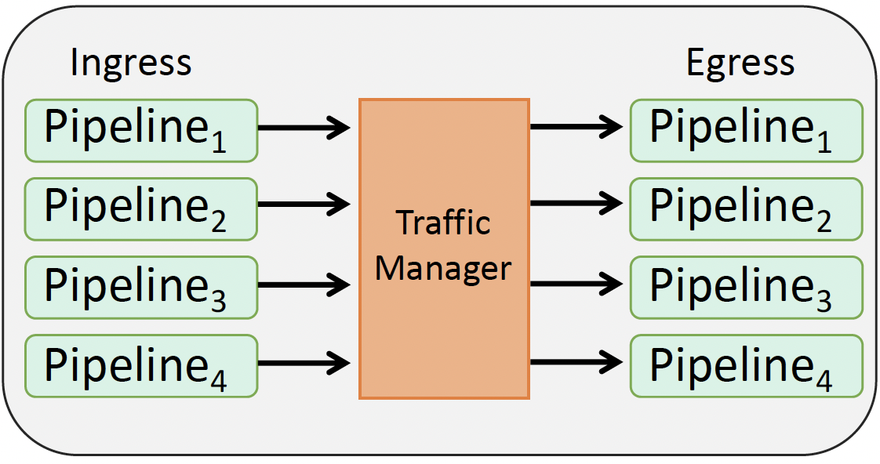
Tofino vs. Trio (Juniper Networks’ programmable chipset)
Packet forwarding engine 1
Packet forwarding engine 3
Interconnection Fabric
…
Packet forwarding engine 2
Packet forwarding engine N
Tofino programmable switches
Trio-based programmable switch
Thread-based architecture
Parser
Match
…
Deparser
Action
Match
Action
Match
Pkt
Action
Pkt
Pkt
Stage 1
Stage 2
Stage 3
Pipeline

Slide 12
Trio’s thread-based architecture
Trio thread
Pkt
Packet forwarding engine 1
Packet forwarding engine 3
Interconnection Fabric
…
Trio thread
Packet forwarding engine 2
Packet forwarding engine N
Trio-based programmable switch

Slide 13
Trio’s thread-based architecture
Packet forwarding engine 1
Packet forwarding engine 3
Pkt
Pkt
Pkt
Pkt
Pkt
Interconnection Fabric
…
Packet forwarding engine 2
Packet forwarding engine N
Pkt
Pkt
Pkt
Pkt
Pkt
Trio-based programmable switch
Trio gracefully handles non-homogeneous packet processing rates

Slide 14
Talk outline
Overview of Juniper Networks’ chipset
Trio-ML: our proposed in-network straggler mitigation for distributed ML training
Evaluations

Slide 15
Challenges for efficient in-network straggler mitigation
In-network straggler detection:
Enable the switch to efficiently detect straggler events
Requires timer-based operations based on user-defined straggler timeout
In-network straggler recovery:
Enable the switch to gracefully serve the job without waiting for stragglers
Requires a light-weight mechanism in the switch to proceed the computation
Our system, Trio-ML, addresses both challenges using Trio’s threads

Slide 16
Challenges for efficient in-network straggler mitigation
In-network straggler detection:
Enable the switch to efficiently detect straggler events
Requires timer-based operations based on user-defined straggler timeout
In-network straggler recovery:
Enable the switch to gracefully serve the job without waiting for stragglers
Requires a light-weight mechanism in the switch to proceed the computation
Our system, Trio-ML, addresses both challenges using Trio’s threads

Slide 17
Trio-ML gradient record
Trio-ML creates a new gradient record when it receives a new packet from server
Trio-based switch memory
Gradient record
Record ID: 1
Job ID: Job₁
List of servers: [S1, S2, S3, S4]
Received gradients: [S1, --, --, --]
Gradient record
Record ID: 1
Job ID: Job₁
List of servers: [S1, S2, S3, S4]
Received gradients: [S1, S2, --, --]
Gradient record
Record ID: 1
Job ID: Job₁
List of servers: [S1, S2, S3, S4]
Received gradients: [S1, S2, S3, --]
Gradient record
Record ID: 1
Job ID: Job₁
List of servers: [S1, S2, S3, S4]
Received gradients: [S1, S2, S3, S4]
Compute aggregated gradients
Trio-based switch
Aggregated gradients
Aggregated gradients
Aggregated gradients
Aggregated gradients
Gradients
Gradients
Gradients
Gradients
Server 1
Server 2
Server 3
Server 4

Slide 18
Naïve approach for in-network straggler detection
Goal: detect non-responsive servers within Δ milliseconds timeout
Trio-based switch memory
Gradient record
Record ID: 1
Job ID: Job₁
List of servers: [S1, S2, S3, S4]
Received gradients: [S1, S2, S3, --]
Naïve approach:
The switch launches a thread and starts a timer as soon as new packets arrive
Trio-based switch
Gradients
Gradients
Gradients
Gradients
Server 1
Server 2
Server 3
Server 4
Straggler

Slide 19
The naïve approach is not scalable for large ML models
Trio-based switch memory
Gradient record 1
(missing gradients from server 4)
Gradient record 2
(missing gradients from server 4)
Gradient record 3
(missing gradients from server 4)
…
The switch would need to create one thread per packet, and is not scalable for large ML models.
…
Trio thread
Trio thread
Trio thread
Trio-based switch
Gradients
Gradients
Gradients
Gradients
Gradients
Gradients
Gradients
Gradients
Gradients
Gradients
Gradients
Gradients
Gradients
Server 1
Server 2
Server 3
Server 4
Servers send lots of gradient packets per training iteration
Straggler

Slide 20
Trio-ML’s approach: decouple timeout threads from packet arrivals
Trio-based switch memory
Thread
Gradient record 1
(missing gradients from server 4)
Gradient record 2
(missing gradients from server 4)
Gradient record M
(missing gradients from server 4)
1
…
Recently Referenced Flag = 1
Recently Referenced Flag = 0
Recently Referenced Flag = 0
Recently Referenced Flag = 1
Recently Referenced Flag = 1
Recently Referenced Flag = 0
Gradient record M+1
(missing gradients from server 4)
Gradient record M+2
(missing gradients from server 4)
Gradient record 2M
(missing gradients from server 4)
2
…
Recently Referenced Flag = 1
Recently Referenced Flag = 0
Recently Referenced Flag = 0
Recently Referenced Flag = 0
Recently Referenced Flag = 1
Recently Referenced Flag = 1
…
…
…
…
…
Gradient record (N-1)M
(missing gradients from server 4)
Gradient record (N-1)M+1
(missing gradients from server 4)
Gradient record NM
(missing gradients from server 4)
N
…
Recently Referenced Flag = 1
Recently Referenced Flag = 0
Recently Referenced Flag = 1
Recently Referenced Flag = 0
Recently Referenced Flag = 1
Recently Referenced Flag = 0
Every Δ timeout interval, Trio-ML launches threads to scan gradient records

Slide 21
Trio-ML’s approach: decouple timeout threads from packet arrivals
Trio-based switch memory
Thread
Gradient record 1
(missing gradients from server 4)
Gradient record 2
(missing gradients from server 4)
Gradient record M
(missing gradients from server 4)
1
…
Time out! Straggler detected
Recently Referenced Flag = 1
Recently Referenced Flag = 1
Time out! Straggler detected
Time out! Straggler detected
Recently Referenced Flag = 1
Gradient record M+1
(missing gradients from server 4)
Gradient record M+2
(missing gradients from server 4)
Gradient record 2M
(missing gradients from server 4)
2
…
Time out! Straggler detected
Recently Referenced Flag = 1
Recently Referenced Flag = 1
Recently Referenced Flag = 1
Time out! Straggler detected
Time out! Straggler detected
…
…
…
…
…
Gradient record (N-1)M
(missing gradients from server 4)
Gradient record (N-1)M+1
(missing gradients from server 4)
Gradient record NM
(missing gradients from server 4)
…
N
Time out! Straggler detected
Recently Referenced Flag = 1
Time out! Straggler detected
Recently Referenced Flag = 1
Time out! Straggler detected
Recently Referenced Flag = 1
After another Δ timeout interval, Trio-ML launches threads to scan gradient records again

Slide 22
Trio-ML’s approach: decouple timeout threads from packet arrivals
Trio-based switch memory
Thread
Gradient record 1
(missing gradients from server 4)
Gradient record 2
(missing gradients from server 4)
Gradient record M
(missing gradients from server 4)
1
…
Time out! Straggler detected
Time out! Straggler detected
Time out! Straggler detected
Gradient record M+1
(missing gradients from server 4)
Gradient record M+2
(missing gradients from server 4)
Gradient record 2M
(missing gradients from server 4)
2
…
Trio-ML guarantees straggler detection within [Δ, 2Δ] timeout window
Time out! Straggler detected
Time out! Straggler detected
Time out! Straggler detected
…
…
…
…
…
Gradient record (N-1)M
(missing gradients from server 4)
Gradient record (N-1)M+1
(missing gradients from server 4)
Gradient record NM
(missing gradients from server 4)
…
N
Time out! Straggler detected
Time out! Straggler detected
Time out! Straggler detected
After another Δ timeout interval, Trio-ML launches threads to scan gradient records again

Slide 23
Challenges for efficient in-network straggler mitigation
In-network straggler detection:
Enable the switch to efficiently detect straggler events
Requires timer-based operations based on user-defined straggler timeout
In-network straggler recovery:
Enable the switch to gracefully serve the job without waiting for stragglers
Requires a light-weight mechanism in the switch to proceed the computation
Our system, Trio-ML, addresses both challenges using Trio’s threads

Slide 24
Trio-ML sends partial aggregation results to recover from stragglers
Trio-based switch
Partial aggregation result
Trio-ML detects straggler
Partial aggregation result
Partial aggregation result
Partial aggregation result
Gradients
Gradients
Gradients
Gradients
Server 1
Server 2
Server 3
Server 4
Straggler
Partial aggregation can achieve comparable convergence performance (Yu et al., [ICML ’19])
Non-straggler servers continue to make progress without waiting
Trio-ML keeps updating the straggler to ensure ML model is consistent

Slide 25
Talk outline
Overview of Juniper Networks’ chipset
Trio-ML: our proposed in-network straggler mitigation for distributed ML training
Evaluations

Slide 26
Testbed setup
Real-world testbed
Comparisons
Our solution: Trio-ML
Tofino-based solution: SwitchML [NSDI ’21]
Ideal setup: PyTorch NCCL RDMA without adding stragglers
Straggler generation pattern (Harlap et al. [SoCC ’16])
Three possible delay points per iteration
One server slows down at each delay point with given straggler probability p
Delay time at each delay point: uniformly randomly chosen between 0.5x and 2x of typical iteration time
Testbed photo

Slide 27
Impact of straggling probability on training iteration time
1.8$×$ speedup
VGG11 on ImageNet dataset

Slide 28
Trio-ML improves the time-to-accuracy by 1.60x
80% Target Accuracy
1.60× speedup
VGG11 on ImageNet dataset
Similar gains for ResNet50 and DenseNet161

Slide 29
Conclusion
Stragglers impose a deployment challenge for in-network computing solutions.
Trio-ML: a novel in-network straggler mitigation system using Juniper Networks’ thread-based programmable chipset.
Trio-ML outperforms today’s in-network aggregation solutions by up to 1.8x.
Please email mingrany@mit.edu for more information!

